Slide 1

Best Ideas
April 2022
QCRH, BANC, and OCFC
By PCW Advisors

Slide 2
Disclaimer
This presentation, furnished on a confidential basis to the recipient, is neither an offer to sell nor a solicitation of any offer to buy any securities, investment product or investment advisory services, including interests in PCW Advisors. This presentation is subject to a more complete description and does not contain all of the information necessary to make an investment decision, including, but not limited to, the risks, fees and investment strategies of the Fund. Any offering is made only pursuant to the relevant information memorandum, together with the current financial statements of the Fund, if available, and a relevant subscription application, all of which must be read in their entirety. No offer to purchase interests will be made or accepted prior to receipt by an offeree of these documents and the completion of all appropriate documentation.
All information provided in this presentation is for informational purposes only and should not be deemed as a guide to investing or a recommendation to buy the securities. There is no guarantee that the opinions express herein will be valid beyond the date of this presentation.
This presentation is not an advertisement and is not intended for public use or distribution and is intended exclusively for the use of the person to whom it has been delivered by PCW Advisors. This presentation is not to be reproduced or redistributed to any other person without the prior consent of PCW Advisors

Slide 3
Summary Of Opportunity
Many strong community banks are significantly undervalued with rates expected to increase over the next few quarters.
There is potential for significant returns over the next few months if investors target banks differentiating themselves from the rest of the group
    Investors should target banks that possess the necessary characteristics to outperform during this rate hiking cycle. So, what are those characteristics?

Slide 4
Characteristics of Banks to Target During Rising Rates
The best banks to invest in will have many if not all the characteristics below:
At or below peers on a valuation basis due to being misunderstood by analysts and the market for reasons such as:
  Recently restructured balance sheet
  The ability to deploy capital profitability has improved dramatically recently
  Cost optimization and profitability improvements have yet to play out
Possess asset sensitive balance sheet that will allow the banks’ NIM to increase as the fed funds rate continues to increase
  Strong core deposits base
  Commercial focused institution
Like any rate environment, the ability to grow loans more than peers
  Located in a strong markets or possess niche lending
  Excess capital to repurchase shares at very reasonable valuation
    Best management teams use excess capital to boost returns to shareholders in a variety of ways
  Track record of pristine credit quality and ability to address credit issues before they happen

Slide 5
Other Factors Benefiting the Banking Industry
3m-10y spread has continues to increase
Short-term Term treasuries such as the 2 year, have increased dramatically
  From discussion with bank management, loan yields pricing has increased substantially
Record excess liquidity will hold down funding costs, and now, the excess liquidity can be deployed at much higher short-term rates
Banks are more efficient than during last rate cycle which will result in even better profitability

Slide 6
The Current Rate Environment – Large Tailwinds
Inflection Point: With the recent increase in rates, banks’ NIM will begin to rise
As of 4/07/2022
Key Thoughts
Funding Costs are not going to increase. The 3M-10-year spread has continued to increase. This chart is much more indicative of the spread between banks’ yield on loans and funding costs than compared to the 2y-10y chart. 3-month treasury rate is much more indicative of what banks funding cost are/will be.
Security Yield are Increasing - Many banks hold a significant amount of excess liquidity earning very little at the Fed. With the recent significant spike in the 2-year rate, banks can now deploy the excess liquidity at higher rates leading to higher NIM.
Loans Yield are Rising - The Fed has made it clear that it is likely to raise fed fund rate both in May and June, with possible 50bps rate increase in both months. Variable rate loans on balance sheets will reprice higher as well as new loans are originating at higher rates.
Payoffs will begin to slow – Payoffs to subside for two reasons:
  Companies with excess liquidity start reinvesting in growth
  Both short-term and long-term rates are increasing reducing the benefit to refinance.
2.70
2.47

Slide 7
2Y-10Y Continue to Expand With NIM Expansion
Inflection Point: If 2Y-10Y spread continues to Rise Banks Stock will Roar!
As of 4/18/2022
Key Thoughts
Recession and credit quality fear will lesson as this spread widens.
Banks are now able to buy securities with a greater than 3% yield for modest duration. Banks are now able to deploy their abundant of excess liquidity in much higher yielding assets

Slide 8
Covid Has Accelerated Digital Transformation
Fact: Targeted Banks’ operating leverage has significantly increased as many functions have been digitalized and overhead expenses have decreased as a % of assets as deposits per branch have increased
With rates low and excess liquidity causing record payoffs, certain banks have not yet shown there greatly enhanced operating leverage
  Banks having just completed a branch consolidation strategy have yet to show their increased profitability from strong loan growth combined with reduced operating expenses (OCFC)
In any business, profitability skyrockets when both Volume and Margin Increase. For Banks, that means Loan Growth and NIM Expansion. I think its time to look at 3 banks that present investors with a significant opportunity for outsized returns due to fitting these two characteristics perfectly

Slide 9
QCRH Overview
Investment Highlights
QCRH has produced ROAA of 1.7% without being reliant on PPP or Mortgage fees
QCRH has niche lending product that will allow it to continue to grow at ~10% pace
Only 5m of NPAs with a Loan Loss Reserve well above its peers at 1.68%
Investment Thesis
With its Acquisition of GFED closing, QCRH liquidity will allow more funds to purchase the stock
QCRH is asset sensitive banks that will benefit from Rising rates
Best-in-class profitability will increase with its NIM expanding
Restarted share repurchase and the market will soon realize QCRH robust earnings potential while it continue to shrink its share count
The bank has several different avenues to increase EPS through organic growth or in market acquisitions in Des Moines IOWA
QCRH is trading a 7X my 2023E earnings, which are conservative especially on NIM guidance. I believe with risings rates the market will not be able to ignore QCRH Earnings and growth rate much longer.
Source: SNL Financial, management conversations

Slide 10
QCRH Key to Success
QCR Holdings Inc. – Started its LIHTC business line in Q3’2018 and as a result, QCRH has been able to grow its loans and has realized a significant amount of swap fees.
In Millions ($)
Key Thoughts
Since beginning its LIHTC unit, QCRH has significantly increased its SWAP fee income.
Swap Fee income went from $10.8m in 2018 to $61.0m in 2021.
  QCRH on its Q4’2021 earnings call said they expect Swap fees to be in the range of 14m-18m a quarter in 2022.
LIHTC business has allowed QCR to grow its core loan portfolio far faster than peers.
  Construction loans grow first followed by stabilized multi-family once property is built
Due to the business line, multi-family and constructions loans have increased significantly.
  Construction loans have increased 518% since and Multi-Family loans increased 355% since Q3’2018
LIHTC loans are far superior credits than traditional multi-family or construction loans due to demand for cheap housing
In Millions ($)
Source: SNL Financial

Slide 11
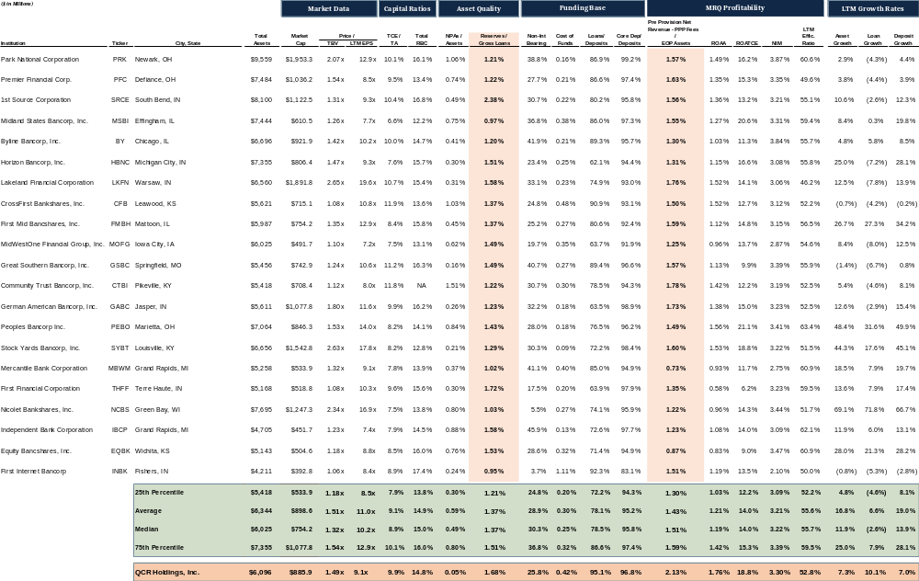
Best in Class Profitability & Credit Profile
Source: SNL Financial

Slide 12
Rankings – QCRH in a Class of its OWN
Source: SNL Financial

Slide 13
Credit Present Little Risk for QCRH
Great Credit Quality with Virtually Zero NPA’s and Significantly Over Reserved
Key Thoughts
QCRH NPA’s have declined since the start of 2021 and now it has only 2.7m of NPAs
QCRH management has made the smart decision to grow into its reserves rather than release them. Due to have significant excess reserves, QCRH is even better capitalized than its capital ratios show
QCRH Management team indicates that it anticipates reducing its level of reserves to peer average which is ~1.4%. However, that range has come down each quarter as its peers release reserves and grow.
QCRH is significantly undervalued on earnings despite above average loan growth, profitability and Credit Quality.
Source: SNL Financial

Slide 14
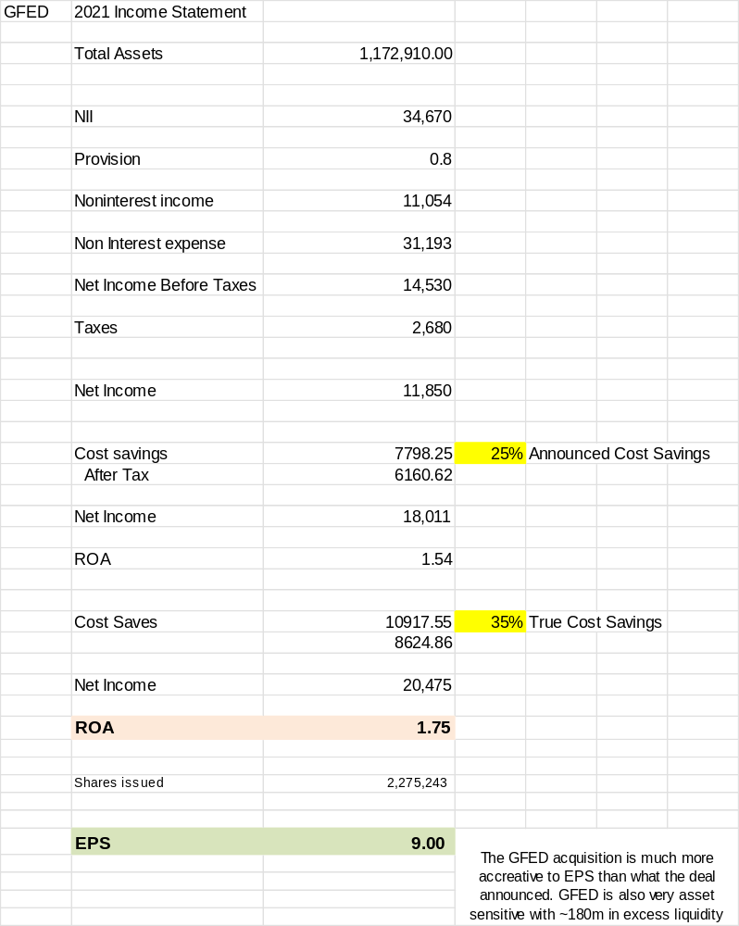
Acquisition of GFED to Accelerate EPS Growth
Key Thoughts
QCRH Closed its acquisition of GFED On April 1, 2022
From speaking with Management, QCRH started to buyback shares on March 25, the day after GFED shareholders voted to approve the deal. QCRH can continue to repurchase shares during blackout period due to having a 10b-5 plan in place
From Speaking with Management and analysis of GFED’s branch map, there will be several branch closures that will bring up the cost saves number substantially
From Management discussions, acquisition of GFED will allow them to add WM group in Springfield increasing non-interest revenue
GFED’s balance sheet balance sheet and excess liquidity increases QCRH’ asset sensitivity.
As seen from the analysis, with 35% cost savings, GFED will produce ~$9.00 EPS, more than the $7.11 I have modeled QCRH to do alone in 2022.
Management has continued to emphasize that excess capital will be used to repurchase shares or in M&A deals. QCRH’s Management is the rare management team that is not obsessed with a large dividend which is very shareholder friendly. Do to QCRH robust profitability, a dividend raise is expected as well.
Source: SNL Financial

Slide 15
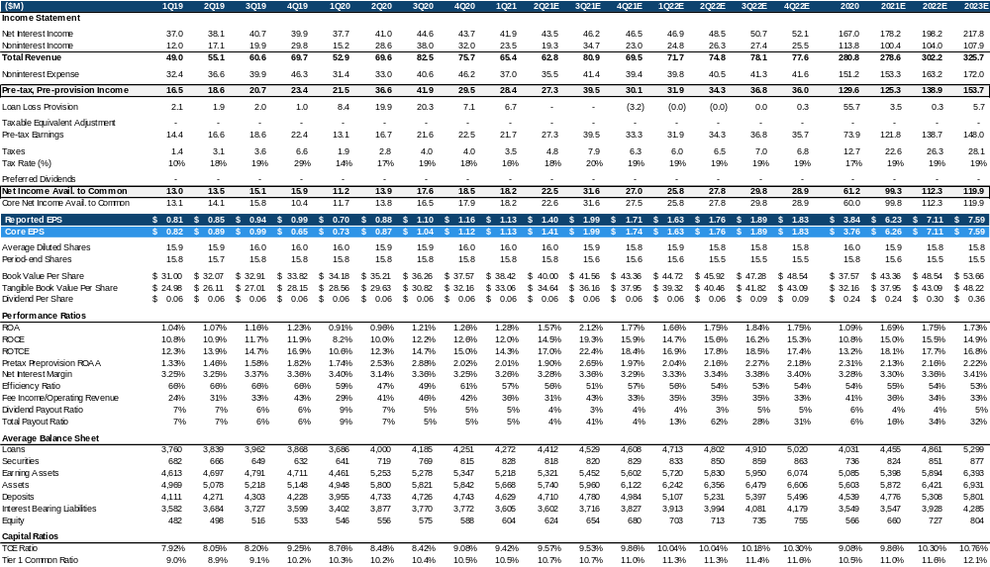
QCRH Stand Alone Projections
Model Details
Conservative model with ROAA and Efficiency ratio staying flat
NIM only increase from 3.30% to 3.41% despite Fed Fund rate expect to increase by at least another 1% by end of 2022
Notice how TCE/TA increases. QCRH will have significant capital to deploy in more repurchases or deals.
Does not include ~`$10m gain in Q2’2022 from securitization of LITCH loans.

Slide 16
Historical Price/TBV Valuation – Significant Upside
When Rates increased last time, QCRH P/TBV was 50% higher than its down. QCRH is significantly more profitability than it was in 2018 when it had a ROAA of just 1.08% and a ROAA of 1.12% in 2019.
QCRH has guiding to 1.7% ROAA without any rate increases. 1.7% ROAA with 8.5% TCE = 20% ROATCE. With its loan growth rate of 8-10%, QCRH at just 10x NTM EPS would trade at ~ 2.50x TBV
As of 4/07/2022
Source: SNL Financial

Slide 17
Banc of California Overview (BANC)
Investment Highlights
BANC is a fast growing $9bn asset bank in Los Angeles and throughout California, which has the 15th largest economy in the world
Has completed a large balance sheet restructuring where in has transformed its balance sheet into relationship focused institutions with niche lending verticals – Jared Wolff Effect
37% noninterest bearing deposits with ~70% of loans are with variable or have hybrid characteristics
Investment Thesis
Asset quality is better that its ratios, BANC originated NPL declined 32% from Q3 and BANC originated criticized or classified loans were down 23% from Q3. Well secured SFR make up most of BANC’s NPA.
Significant improvement in Management over the last 3 years with the hiring of Jared Wolf from PACW. Under Jared’s leadership, BANC has redeemed all its preferred stock and has build up significant excess which is being used to repurchase shares – Deployed capital profitably. Shareholder friendly board with both PL Capital and Patriot with seats.
Acquisition of PMBC and its asset sensitive balance will lead to an improvement in ROAA due to improve efficiency and the benefit of rising rates
Growth and Asset sensitive balance sheet will lead to large jump in profitability
Banc trading at 8X my 2023E earnings. I believe with risings rates the market will favor Banks like BANC whose NII is rising rapidly due to both loan growth and NIM expansion. Additionally, BANC holds significant scarcity value as the only Los Angeles based bank between $5-$10bn in assets.
Source: SNL Financial, management conversations

Slide 18
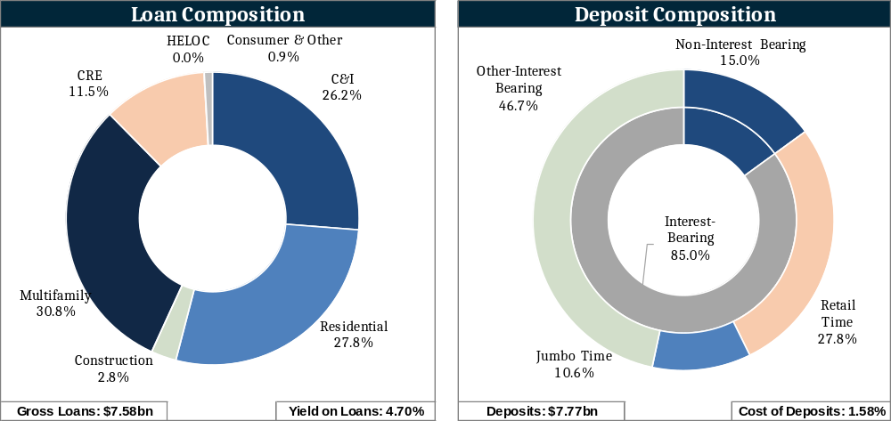
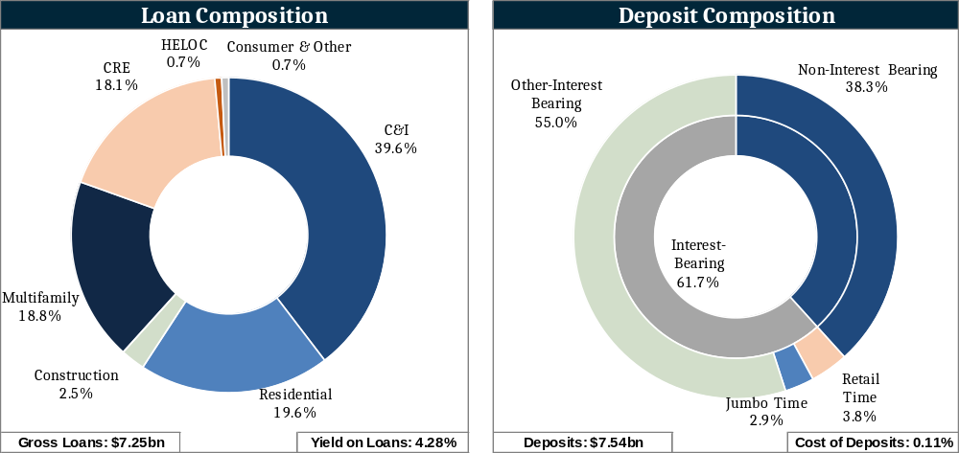
Significant Balance Sheet Improvement
Q1’2019
Jared Wolff Effect
Significant improvement in funding profile with NIB deposits increasing from 15% to 38.3% is just 3 years
BANC ran off non relationships loans which has significantly improved its deposits profile and balance sheet
BANC has focused on growing higher risk adjusted return lending that takes Skilled lenders and come with full relationships
  C&I concentration is up 50% to 39%.
  CRE concertation has increased to 18.1% from 11.5%
Through its balance sheet optimization, BANC’s asset sensitivity has improved significantly:
  One Year Gap ratio at the end of 2018 was -1.94% compared to today of 34.32%
Additionally, BANC has Redeemed all its preferred shares saving $4.3m every quarter compared to Q1’2019. Last of the preferred was paid off on March 15, saving $1.73m each quarter
Q4’2021
Source: SNL Financial
Source: SNL Financial, management conversations

Slide 19
Loan Growth Driven by C&I
Balance Sheet Poised to Benefit from Rising Rates
BANC has transformed itself into a relationship focused banks serving middle market operating business.
Some of the banks loans growth has replaced run-off of its non-core portfolio resulting in just modest loan growth
The Acquisition of PMBC has accelerated BANC’s balance sheet transformation resulting in more NIB deposits and commercial relationships
BANC’s balance sheet transformation is nearly complete. Without the need to run off loans, Loan growth is expected to be robust over the next fee years, in the low double digits over the next few year:
Loan growth modeled at 9.5% and 10.6% from 2022 and 2023
Source: SNL Financial
Source: SNL Financial, management conversations

Slide 20
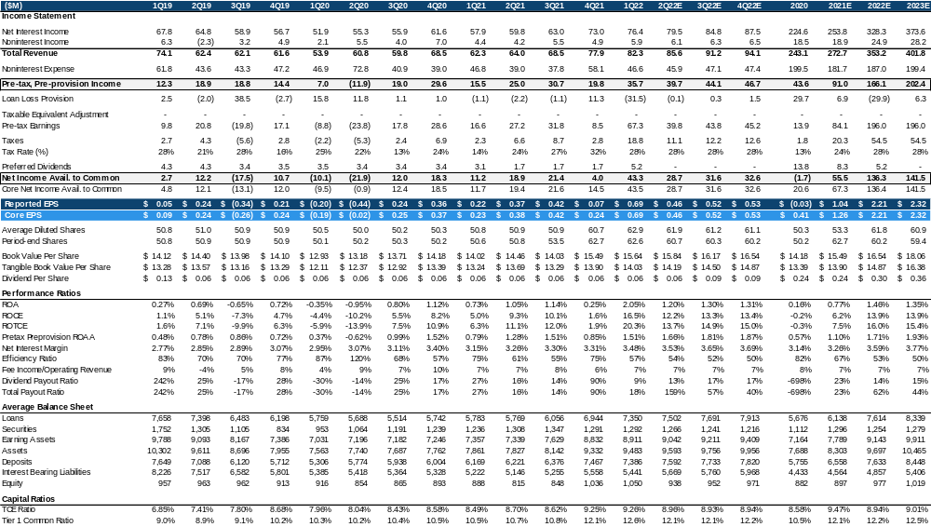
BANC Projections – Post Q1 Earnings
Model Details
Conservative model with loan growth 10.0%
Core NIM increased from 3.28% to 3.39% QoQ. Fed Fund rate expect to increase by at least another 1% by end of 2022 and its extremely asset sensitive balance sheet
Model includes $107M of share repurchase, $75M through Q1’2023
Provision expense lower in 2022 due to Credit marks from PMBC deal
Accretion income modeled to go down $500k a quarter by Q4’2022. was ~$2M in Q1.

Slide 21
OCFC Overview
Investment Highlights
Trading below 1.2x TBV despite growing loans 11% over the last quarter
Asset sensitive balance should significantly increase the Bank’s NIM while L/D ration to increase also benefit NIM
Significant operating leverage to be gained during the rest of 2022 with 33% of branches being closed during Q4’2021 and Q1’22. Deposits per branch at ~$240m currently
Investment Thesis
Serial acquiring just completing its cost savings by closing 33% of its branch. Market is not valuing the operating leverage gain through the recent cost cutting measures:
OCFC ROAA is poised to increase substantially due to:
  Substantial Loan growth increasing Loan/Deposits ration – NIM Improvement
  Asset sensitive balance sheet positions the bank’s NIM to rise as fed raised rates
  Operating expenses to fall.
OCFC continues to repurchase shares as good valuation
Partners deal not to close until the 2nd half of the year will boost EPS due to the cash in the deal. Overall, I am neutral on the deal.
OCFC is trading a 7.5X my 2023E earnings. Model only has NIM reaching 3.30% in Q4’2023 which could happen far sooner depending.
Source: SNL Financial, management conversations

Slide 22
Significant Organic Loan Growth
Strong Organic Growth
OCFC is now beginning to see the benefits of its expansion into the Boston, Philly, and DC markets through hiring teams
Organic growth is even greater than shown due to run off of 60m in PPP loans since Q2’2021
Despite its robust loan growth last 2 quarters, OCFC pipeline is higher at the end of the Q4 compared to Q3.
  Average Rate on current Pipeline is 3.55% compared to rate on Q4’2021 originations of 3.24%
  Rates have risen over the Q1’2022, the expectation is rate on origination in this quarter will be higher than what is currently in the pipeline
Strong Pipeline As Well
Source: SNL Financial
Source: SNL Financial, management conversations

Slide 23
Significant Expense Optimization
Profitability Improvement on the Horizon
OCFC has made several software and technological enhancement which has allowed to them meet the ever-changing needs of its client’s
OCFC has been able to reduce its branch counts 40% since Q2’2021 which will result in much better profitability
  OCFC will have less expenses, OCFC Q2’2022 results which be able to show the enhance operating leverage which result in marketable improvement in ROAA
  OCFC will have grown loans over $1bn with higher interest will results in significant jump in profitability which the market is currently overlooking
  OCFC has already reduced headcount by ~50 in Q4, I expect around the same number of cuts in Q1’2022
Source: SNL Financial
Source: SNL Financial, management conversations

Slide 24
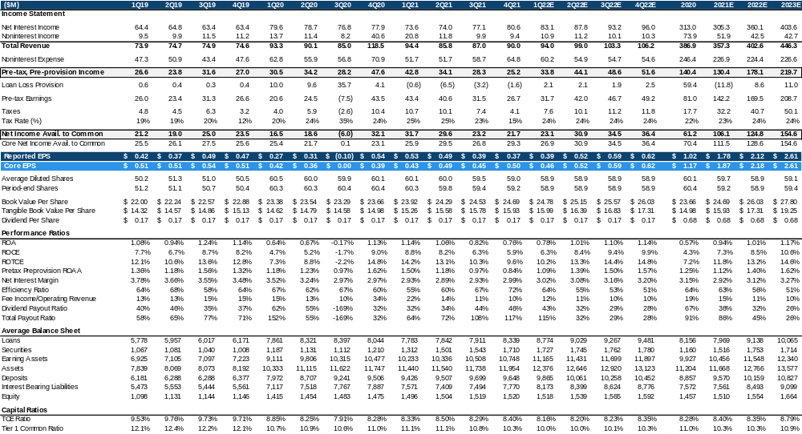
OCFC Standalone Projections
Model Details
Efficiency Ratio improvement due to branch rationalization completed in Q1’2022
NIM only increase from 2.99% to 3.00% despite Fed Fund rate expect to increase by at least another 1% by end of 2022. 3.30% NIM is much lower than OCFC had in last rate cycle
Includes no fee income growth
Noninterest expense in 2021 and 2022 is high due to non-recurring expenses from branch closures

Slide 25
Historical Price/TBV Valuation – Significant Upside
When Rates increased last time, OCFC P/TBV was 50% higher than its down. OCFC has significantly more operating leverage with deposits/branch doubling to ~$240m
OCFC is set up to do 1.2 ROAA as it deploys its excess cash into higher yielding Assets. Loan growth should far excess its peer group. OCFC at just 10x 2023 EPS would trade at ~ 1.65x TBV. As shown, OCFC has much more potential than that.
As of 4/07/2022
Source: SNL Financial

